Slide 2
Content

Slide 3
Theory
Stability of system : We can give definition of stability in numbers of ways depending upon the kind of system, here we will consider our definition for linear and time invariant systems
Types of system depending upon stability
1) Asymptotically stable
2) Unstable
a. Divergent instability
b. flutter instability
3) Stable
We will use linear differential equation to derive and solve equation of motion of given problem statement

Slide 4
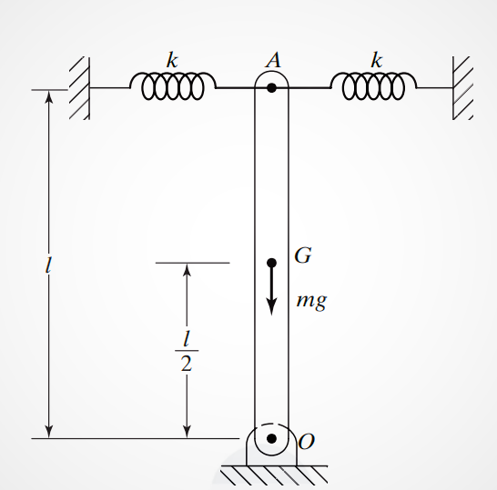
Problem statement
Consider a uniform rigid bar of mass m and length l, pivoted at one end and connected symmetrically by two springs at the other end.(see fig.)
Derive the equation of motion of the system for small angular displacements (θ) of the bar about the pivot point.
Assumption: the springs are unstretched
when the bar is vertical.
Also assume small angular displacement.
make an investigation about the stability
behavior of the system.

Slide 5
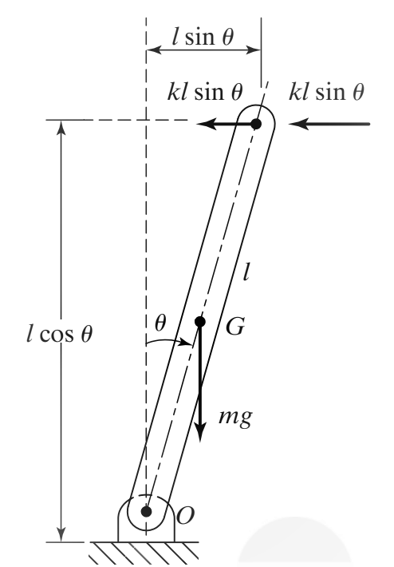

Solution
$$θ$$
Let we displace the bar at an angle as shown in fig.
Spring force in each spring will be
And total spring force will be
Weight of the bar will be vertically downward and given by,
W = mg
To get general equation of motion we will take moment about
point O,
Where, and

Slide 6
Now according to the assumption, angle of deflection is very small therefore,
Where,
Since we don’t know the specific value of we will assume three different conditions,
Condition1: if , then,
i.e,
therefore required solution will be
where,

Slide 7
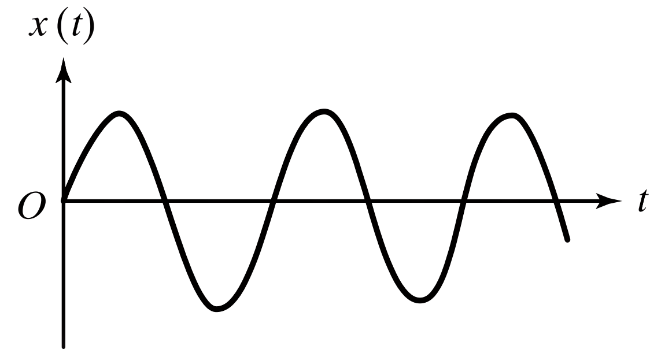
Above equation represents stable system with stable oscillations as shown in graph below,
Condition2: if , then,
integrating o both side,
Where and are constant of integration
Let the initial conditions be, and

Slide 8
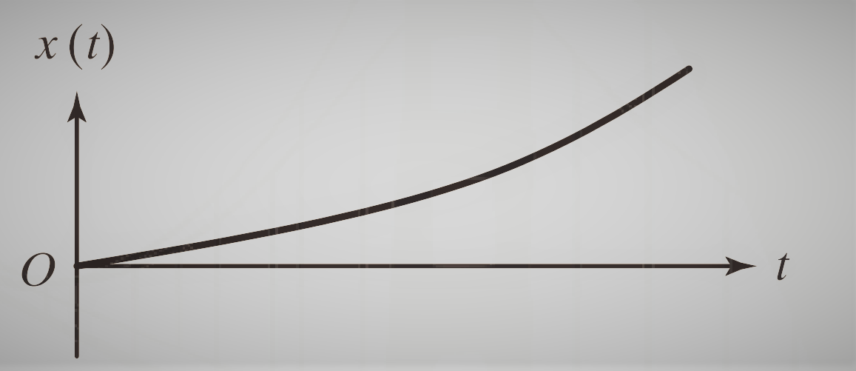
Above equation shows that the system is unstable with the angular displacement increasing linearly at a constant velocity .Which shows divergent instability.(fig)
However, if above Eq. will denote a stable or static
equilibrium position with that is the bar or pendulum
remains in its original position, define by
condition3: if then,
Above equation shows that increases exponentially with time and hence system is unstable. This is because the restoring moment due to the spring position is less than the testoring moment due to gravity

Slide 9
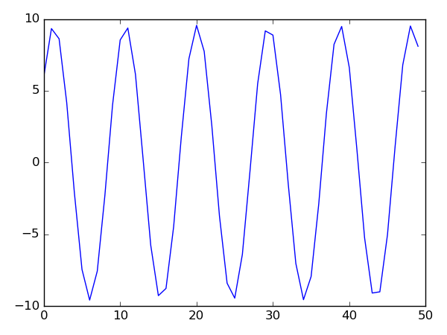
Conclusion
We tried to build a python program to cross-check our results for that we took values spring constant(k)=0.5N/m^2,length of rod(l)=100m, gravity(g)=10m/s^2(approx.). Mass is variable with respective to conditions.
Initial Angle of deflection is 6degree and constant angular velocity is 5 rad/sec
For condition1: Mass=5kg

Slide 10
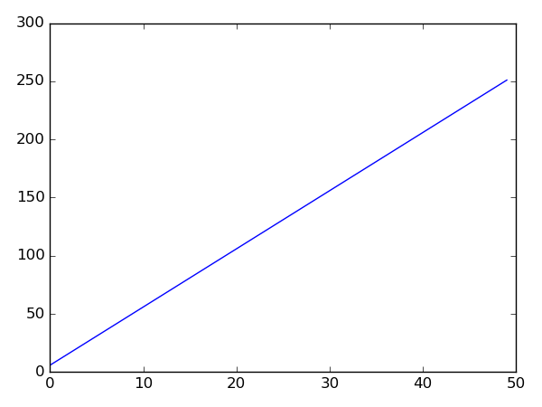
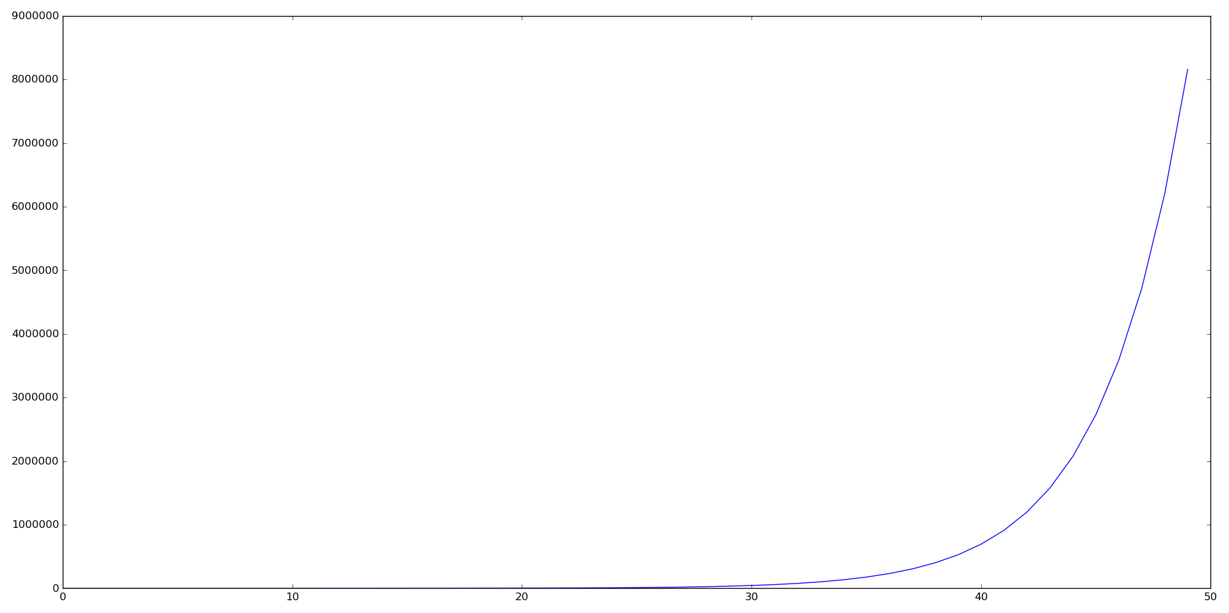
For condition2:
For condition3:

